Slide 1
Model Training
Tuning, Training and Evaluation

Slide 2
Steps to Training a Model
Split dataset into training and testing
Declare hyperparameters to tune
Fit and tune with cross validation
Evaluate the models

Slide 3
Splitting Dataset
Think of your data as a limited resource.
You can spend some of it to train your model (i.e. feed it to the algorithm).
You can spend some of it to evaluate (test) your model.
But you can’t reuse the same data for both!

Slide 4
Splitting Dataset
If you evaluate your model on the same data you used to train it, your model could be very overfit and you wouldn’t even know!
A model should be judged on its ability to predict new, unseen data.

Slide 5
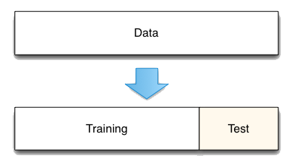
Splitting Dataset
Therefore, you should have separate training and test subsets of your dataset.
Notes:
Training is used to train the models
Test is used to test the training models
Usually good rule of thumb is 80/20 split

Slide 6
Splitting Dataset
Training sets are used to fit and tune your models. Test sets are put aside as "unseen" data to evaluate your models.
You should always split your data before doing anything else.
This is the best way to get reliable estimates of your models’ performance.
After splitting your data, don’t touch your test set until you’re ready to choose your final model!

Slide 7
Model Parameters vs Hyperparameters?
The key distinction is that model parameters can be learned directly from the training data while hyperparameters cannot.

Slide 8
Model Parameters
Model parameters are learned attributes that define individual models
e.g. regression coefficients
e.g. decision tree split locations
They can be learned directly from the training data

Slide 9
Hyperparameters
Hyperparameters express "higher-level" structural settings for algorithms.
e.g. strength of the penalty used in regularized regression
e.g. the number of trees to include in a random forest
They are decided before fitting the model because they can't be learned from the data

Slide 10
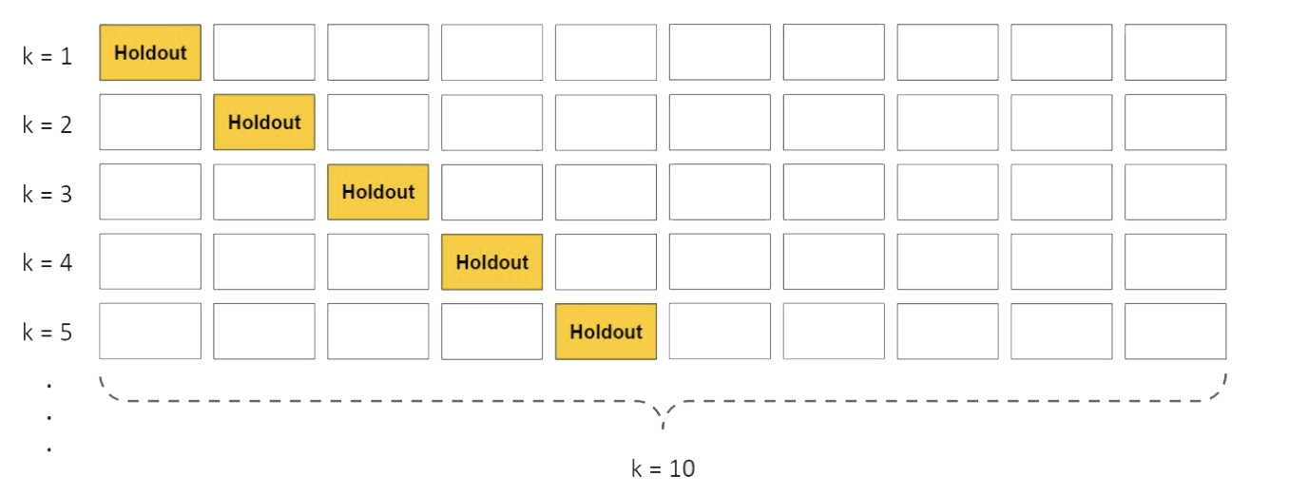
Cross-Validation
Notes:
Cross-validation is a method for getting a reliable estimate of model performance using only your training data.
There are several ways to cross-validate. The most common one, 10-fold cross-validation, breaks your training data into 10 equal parts (a.k.a. folds), essentially creating 10 miniature train/test splits.

Slide 11
Cross-Validation
Steps for 10-fold cross-validation:
Split your data into 10 equal parts, or "folds".
Train your model on 9 folds (e.g. the first 9 folds).
Evaluate it on the 1 remaining "hold-out" fold.
Perform steps (2) and (3) 10 times, each time holding out a different fold.
Average the performance across all 10 hold-out folds.
Notes:
The average performance across the 10 hold-out folds is your final performance estimate, also called your cross-validated score.
Because you created 10 mini train/test splits, this score is usually pretty reliable.

Slide 12
Fit and Tune Models
The high-level pseudocode looks like this:
For each algorithm (i.e. regularized regression, random forest, etc.): For each set of hyperparameter values to try: Perform cross-validation using the training set. Calculate cross-validated score.
Notes:
Basically, all we need to do is perform the entire cross-validation loop detailed above on each set of hyperparameter values we'd like to try.

Slide 13
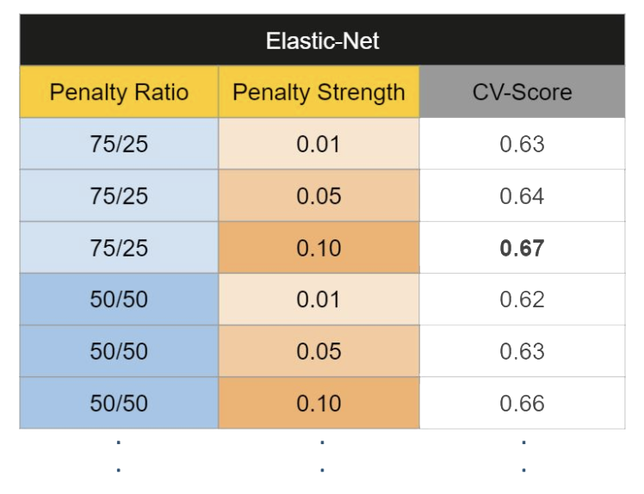
Fit and Tune Models
At the end of this process, you will have a cross-validated score for each set of hyperparameter values... for each algorithm.

Slide 14
Model Evaluation
There are a variety of performance metrics you could choose from:
For regression tasks, we recommend Mean Squared Error (MSE) or Mean Absolute Error (MAE). (Lower values are better)
For classification tasks, we recommend Area Under ROC Curve (AUROC). (Higher values are better)
Notes:
Because you've saved your test set as a truly unseen dataset, you can now use it get a reliable estimate of each models' performance.

Slide 15
Model Evaluation
The process is very straightforward:
For each of your models, make predictions on your test set.
Calculate performance metrics using those predictions and the "ground truth" target variable from the test set.

Slide 16
Model Evaluation
Finally, use these questions to help you pick the winning model:
Which model had the best performance on the test set? (performance)
Does it perform well across various performance metrics? (robustness)
Did it also have (one of) the best cross-validated scores from the training set? (consistency)
Does it solve the original business problem? (win condition)

